Slide 1
Final Presentation
SVBRDF Estimation using a Physically-based Differentiable Renderer Markus Andreas Worchel

Slide 2
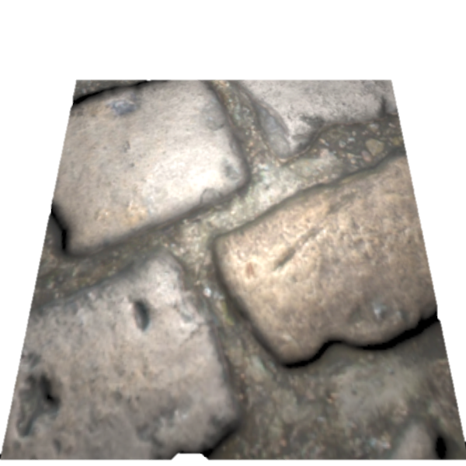
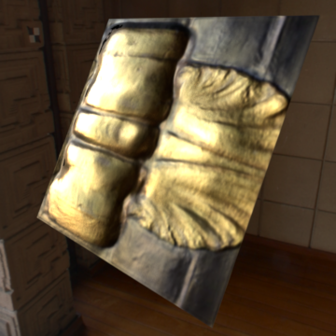
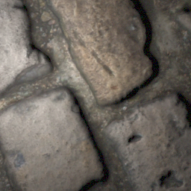
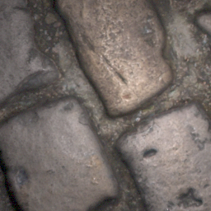
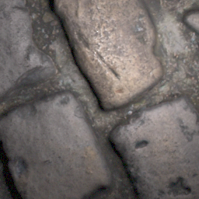
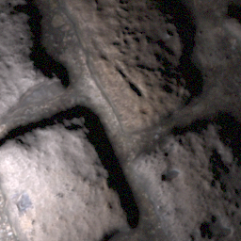
Recap – Topic
…
…
…
…
…

Slide 3
Recap – Approach
…
CNN
…
…
…
[1, 2]
…
[1] Deschaintre et al., 2018, Single-Image SVBRDF Capture with a Rendering-Aware Deep Network [2] Deschaintre et al., 2019, Flexible SVBRDF Capture with a Multi-Image Deep Network

Slide 4
Recap – Project Scope
Differentiable Pathtracer
[3]
…
CNN
…
…
…
[1, 2]
…
[1] Deschaintre et al., 2018, Single-Image SVBRDF Capture with a Rendering-Aware Deep Network [2] Deschaintre et al., 2019, Flexible SVBRDF Capture with a Multi-Image Deep Network
[3] Li et al., 2018, Differentiable Monte Carlo Ray Tracing through Edge Sampling

Slide 5
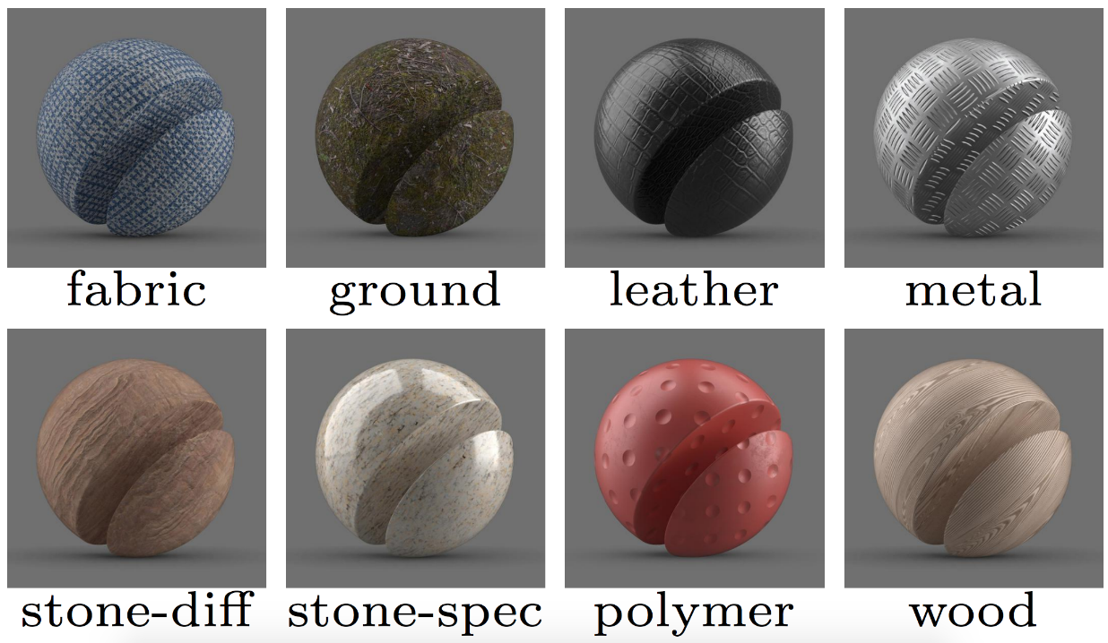
Recap – Motivation
Why material estimation?
Holistic 3D reconstruction (geometry + material)
Photorealistic assets for
Games
Movies
Cultural heritage
…
Multi material 3D printing
Why using a differentiable pathtracer?
General approach (independent of use case)
Flexible light transport simulations

Slide 6
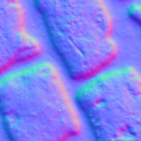
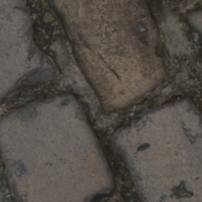
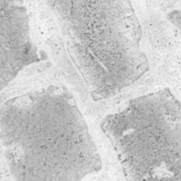
Algorithm – Data
SDR Image
Normal
Diffuse Albedo
Roughness
Specular Albedo

Slide 7
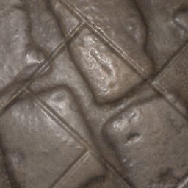
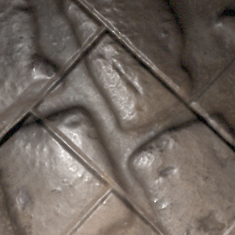
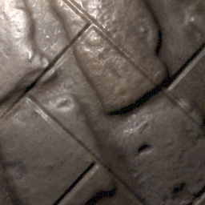
Algorithm – Data
Material mixing
Augmented image generation
…

Slide 8
Algorithm – Overview
Data Reader
Encoder
Decoder
Loss
…
…
Global Track

Slide 9
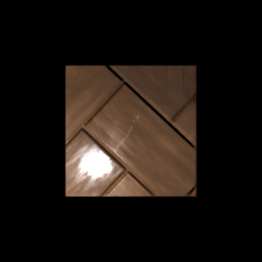
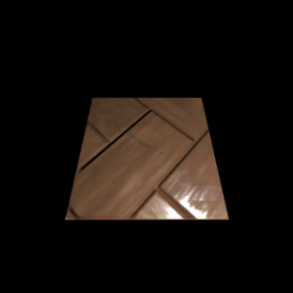
Algorithm – Loss
-
+
-
$$\underset{\text{L}\text{1 }\text{Loss}}{\underbrace{ }}$$
$$\underset{\text{Rendering} \text{Loss}}{\underbrace{ }}$$

Slide 10
Algorithm – Differentiable Renderers
Renderer for direct illumination implemented using PyTorch (local)
Redner pathtracer implemented in C++
with PyTorch bindings (pathtracing)

Slide 11
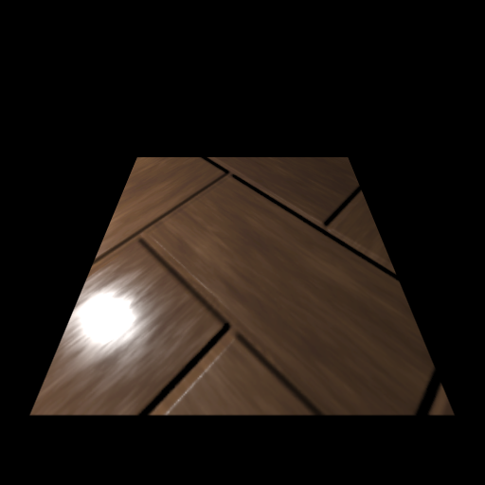
Algorithm – Renderer Output
Problem: No gradient information for weight optimization

Slide 12
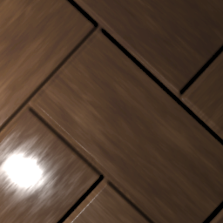
Algorithm – Renderer Output
Problem: No gradient information for weight optimization
Solution: Full patch sampling

Slide 13
Algorithm – Patch Sampling
✓
Notes:
Explanation of manual derivates in C++ and video showing that the derivatives work (material optimization by comparing renderings)

Slide 14
Algorithm – Patch Sampling in Redner
✓

Slide 15
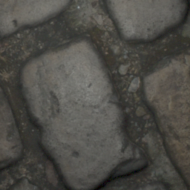
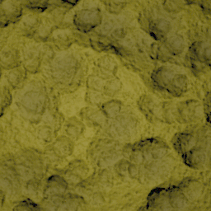
Results – Artificial Images (1)
Ground Truth
Reference (400k)
Local (285k)
Pathtracing (17k)

Slide 16
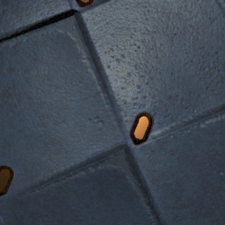
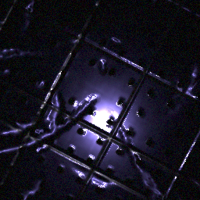
Results – Artificial Images (2)
Ground Truth
Reference (400k)
Local (285k)
Pathtracing (17k)

Slide 17
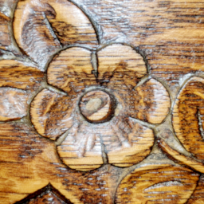
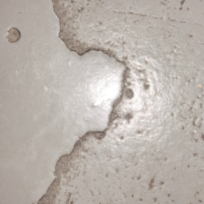
Results – Real Images (1)
Reference (400k)
Local (285k)
Pathtracing (17k)

Slide 18
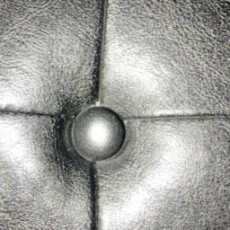
Results – Real Images (2)
Reference (400k)
Local (285k)
Pathtracing (17k)

Slide 19
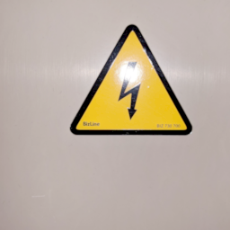
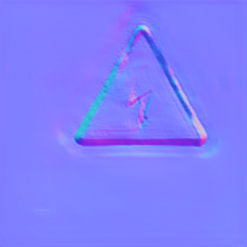
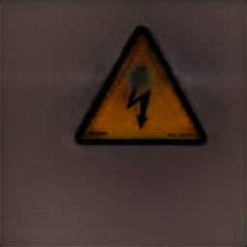
Limitations – The Obvious
Correlated SVBRDF maps
Assumtion of mostly flat macro geometry
Training with pathtracer is ~25 times slower

Slide 20
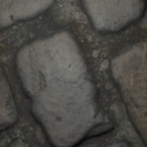
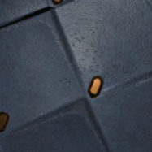
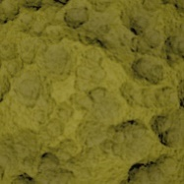
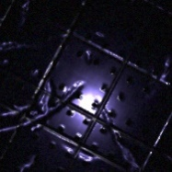
Limitations – Wrong/Noisy Gradients?

Slide 21
Limitations – Wrong/Noisy Gradients?
✗

Slide 22
Limitations – Wrong/Noisy Gradients?
✗

Slide 23
Limitations – Wrong/Noisy Gradients?
✓

Slide 24
Limitations – Wrong/Noisy Gradients?
✗

Slide 25
Outlook
Finding and fixing potential bugs
More optimized implementation
Generic geometry
BSDF estimation

