Slide 1
Intermediate Presentation
SVBRDF Estimation using a Physically-based Differentiable Renderer Markus Andreas Worchel

Slide 2
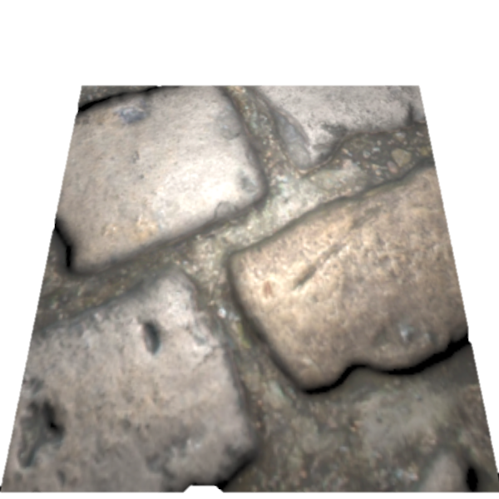
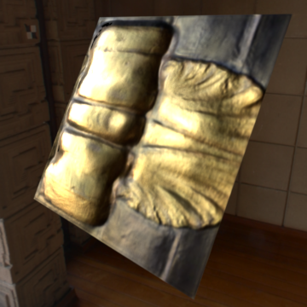
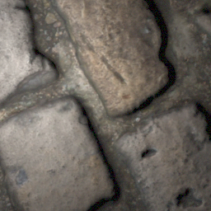
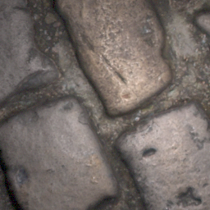
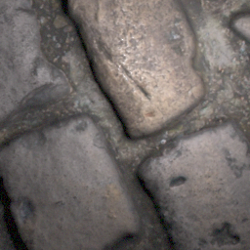
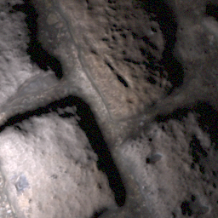
Recap – Topic
Physically-based
Differentiable Renderer
…
CNN
…
…
…
…

Slide 3
Recap – Schedule
Download database
Acquire testing and training code for the network
Get familiar with papers, source code and data
Acquire code for Mitsuba 2
Replace rendering layers of the network with Mitsuba 2
Evaluation (compare with unmodified method)

Slide 4
Data
Single-view database (87 GB)
Input image and material variations generated offline
Reading implemented ✓
Multi-view database (1.4 GB)
Input images and material variations generated at load time
Reading (generation) not yet implemented –

Slide 5
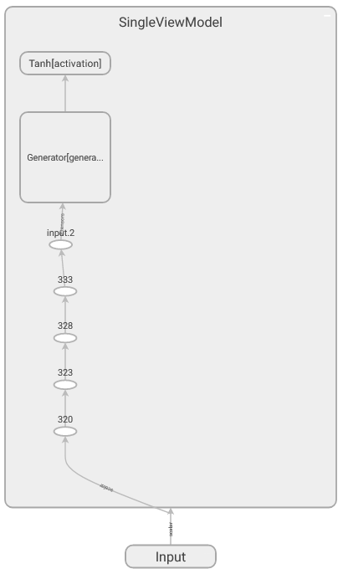
Models
Single-view model (Deschaintre et al., 2018)
Implement in pyTorch ✓
Verify model using visualization in TensorBoard ✓
Report bugs back to author ✓
Multi-view model (Deschaintre et al., 2019)
Implement in pyTorch ✓ → Only 40 LoC more than single-view model
Verify model using visualization in TensorBoard –

Slide 6
Training Loss
Prediction
Ground Truth
CNN
…
…
…
?

Slide 7
Loss – From L1 to Mixed Loss
L1 loss between SVBRDF maps was implemented last time
$$L_{1}≔\left| − \right|+\left| − \right|+\left| − \right|+\left| − \right|$$
Now: Mixed Loss $L≔\underset{\text{rendering} \text{loss}}{\underbrace{|R\left( \right)−R\left( \right)|}}+λL_{1}$
Rendering operator $R$ requires scenes and a differentiable renderer

Slide 8
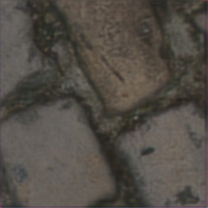
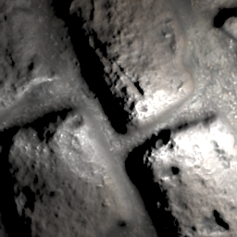
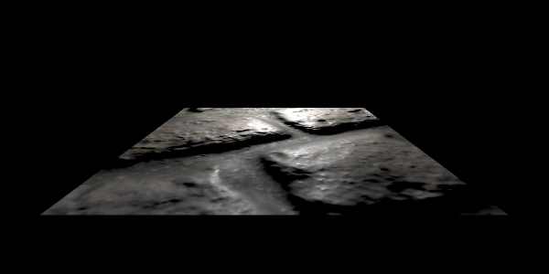
Loss – Renderer
Implement simple differentiable renderer ✓
Only considers direct illumination
Lambertian diffuse term
Cook-Torrance specular term
Renders SVBRDF on flat material patch in the origin (virtual orthographic view)
💡
📷
Perspective
Orthographic

Slide 9
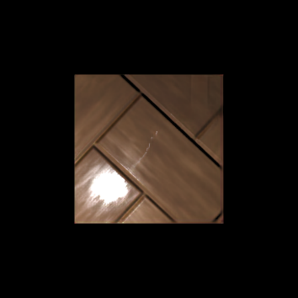
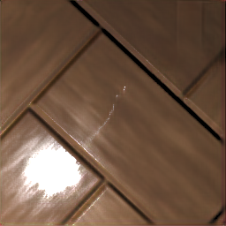
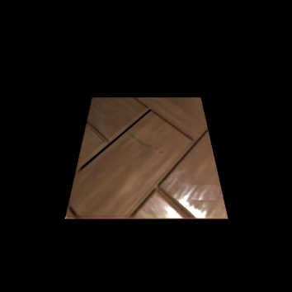
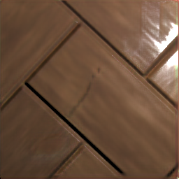
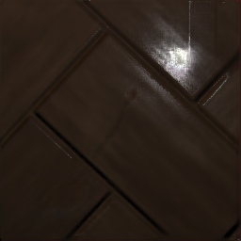
Loss – Scenes
One camera, one light ✓
Random camera and light positions per sample in mini batch –
Required for unbiased appearance comparison
Currently only three fixed configurations:

Slide 10
Loss – Results
Input
Ground Truth
L1 Loss
Mixed Loss (L1 + Rendering)
Notes:
2 training samples
3000 Epochs

Slide 11
Replacing the Simple Renderer
Mitsuba 2 still not released
Fall back to Redner ✓
Redner is not compatible with Windows
Patch Redner code (MSVC intrinsics, install script) ✓
Send PR to upstream repository ✓
Uses OpenEXR python bindings (no Windows compatibility)
Patch OpenEXRPython code ✓
Send PR to upstream repository ✓
Redner GPU (CUDA) not compatible with Windows
Patch Redner Code –
Send PR to upstream repository –

Slide 12
Replacing the Simple Renderer – Challenges
Integration into rendering loss and current structure –
Redner scene definition vs. my scene definition
Virtual orthographic rendering
Training time feasibility check –
Path tracing is resource and time demanding
GPU implementation is probably a must
Evaluation –
Full training of models
Qualitative (and quantitative) comparison
Training time comparison

Slide 13
Conclusion
Still some work to do… …but most difficult tasks are finished or basis is established
Redner in action (path tracing our SVBRDFs):

